Slide 1





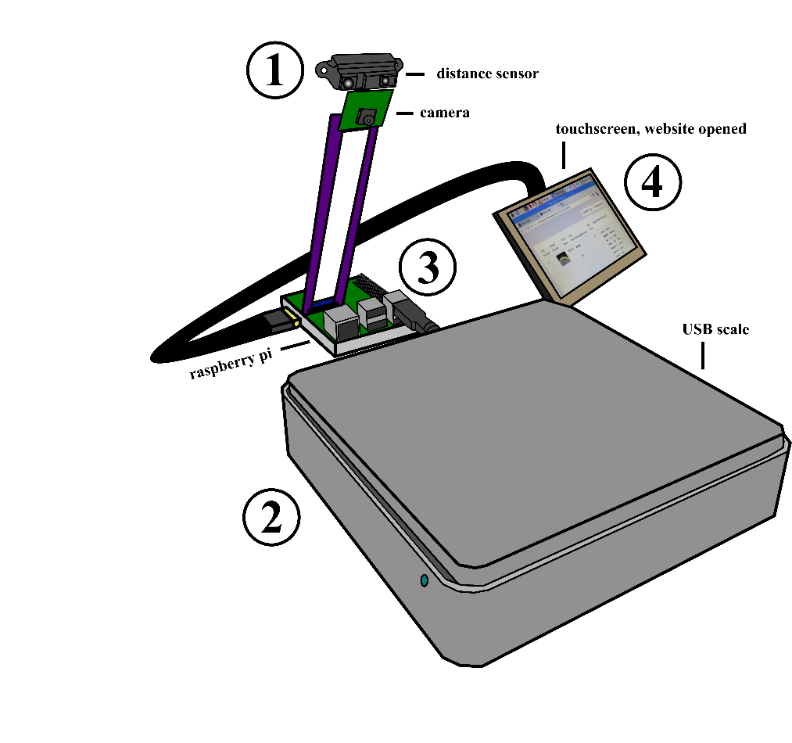
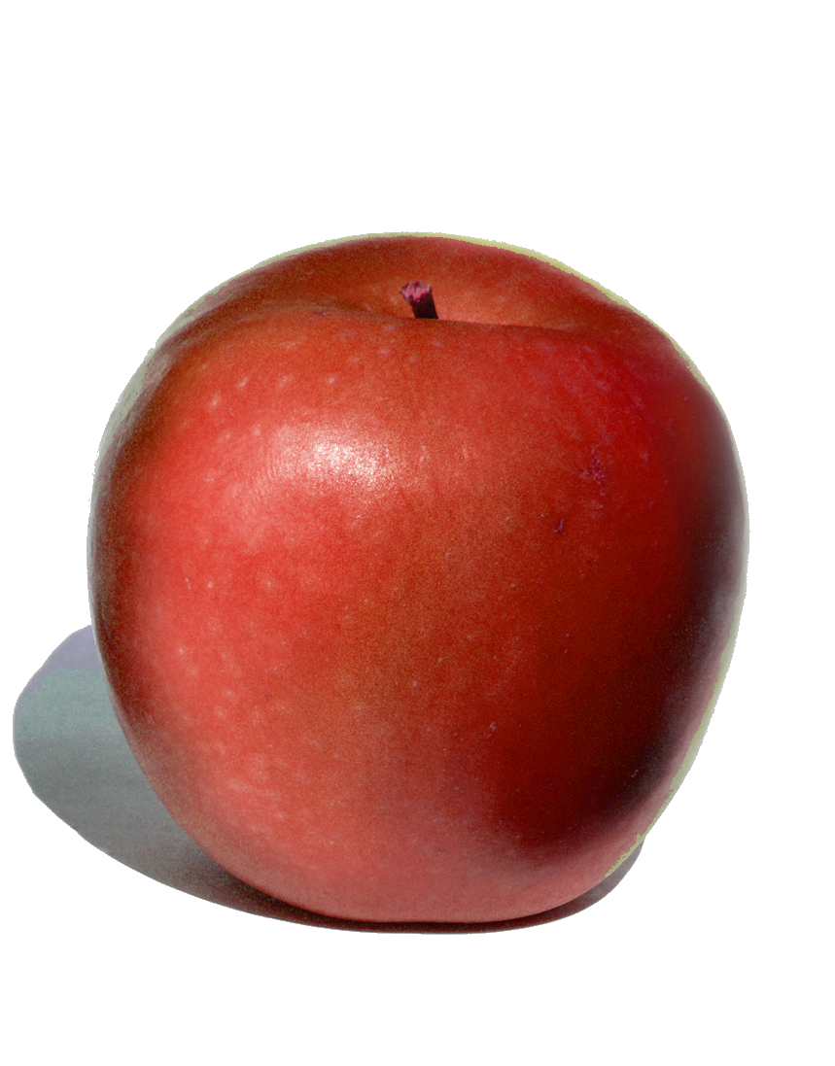

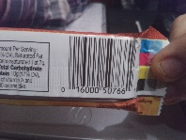
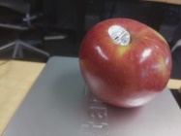
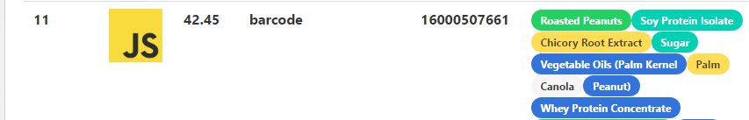
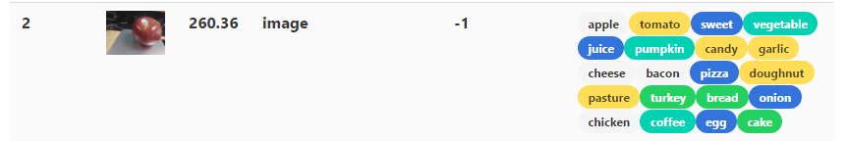
Food Diary, an Internet-of-Things Health Application
Created by Deepankar Malhan and Austin Miller
Advised by Professor Stan Kurkovsky
Additional Credits:
- Barcode Scanning
- Image Manipulation
- Food-Image Analysis
- Nutritional Data Lookup
pigpio library - Pi GPIO pins
- Image Hosting
Abstract:
Application Flow:
4) All food entries are pending until user approves them. If image of food was given, website will determine potential ingredients through Clarifai, and the user can select which ones are correct on the screen. Then, website will determine nutritional data by calling nutritionix with either the ingredients or the barcode.
Words.
Results:
Situation:
Application Photo:
Objectives:
Raspberry Pi uses sensors to collect and make decisions on food-data
Pi connects with external web service that stores and acts on data
Application provides user accurate method of recording daily nutrition
Application allows user to add food with or without barcode
User does not need additional input devices to use application
Pending Log:
Approved Log:
While waiting for food to be placed on scale, check distance sensor. If object is in range, take photo and assume that it is of a barcode
When mass reported by scale changes, take a photo only if a photo has not already been taken (of a barcode). Record mass.
If a photo of a barcode was taken, determine the UPC code of the food. If a photo of food was given, upload the image to Imgur. Send mass and UPC or Imgur id to website.
Placeholders…
Overall Daily Log:

